Slide 1
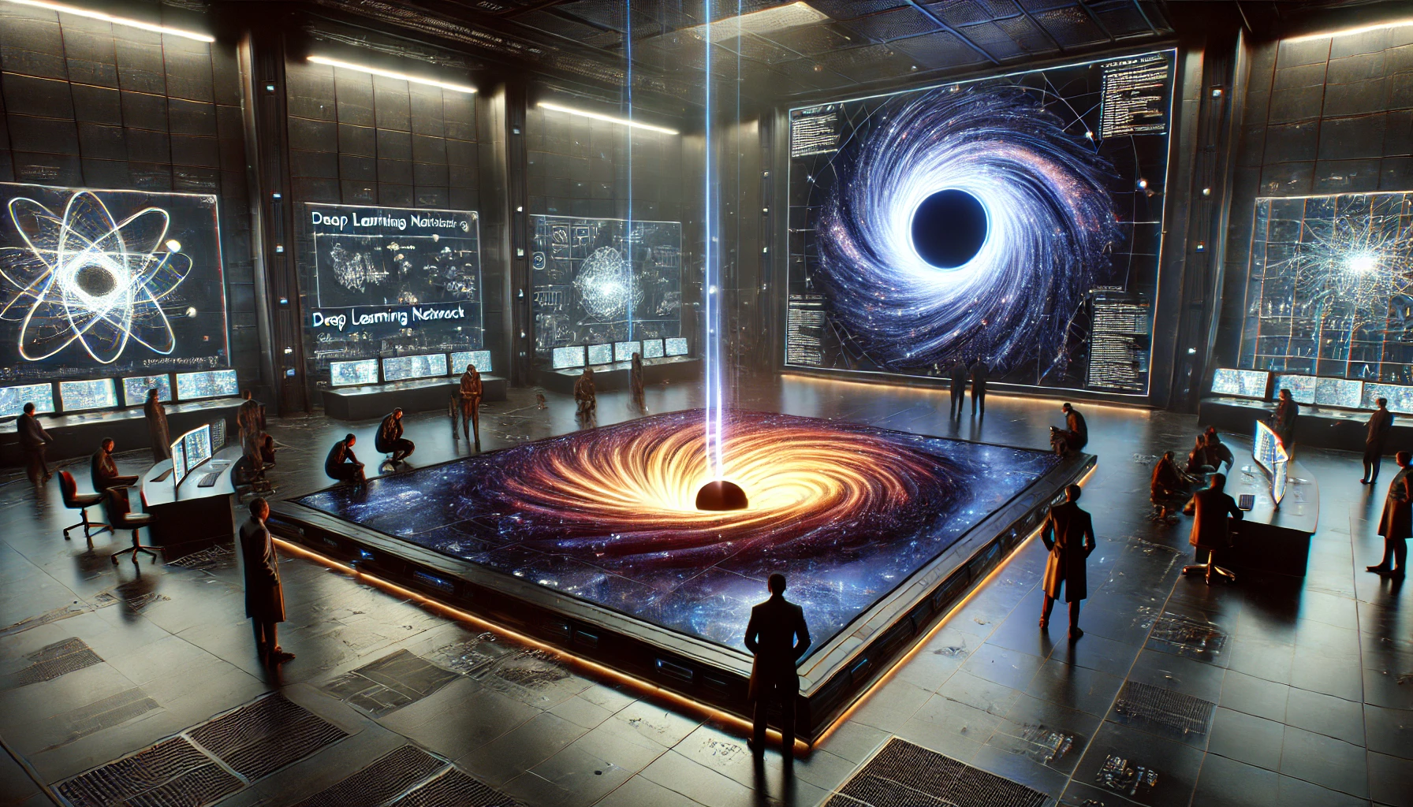
Faster Models, Faster Answers
Discover Emulation for your Workflow
PyData Southampton 15th October 2024

Slide 2
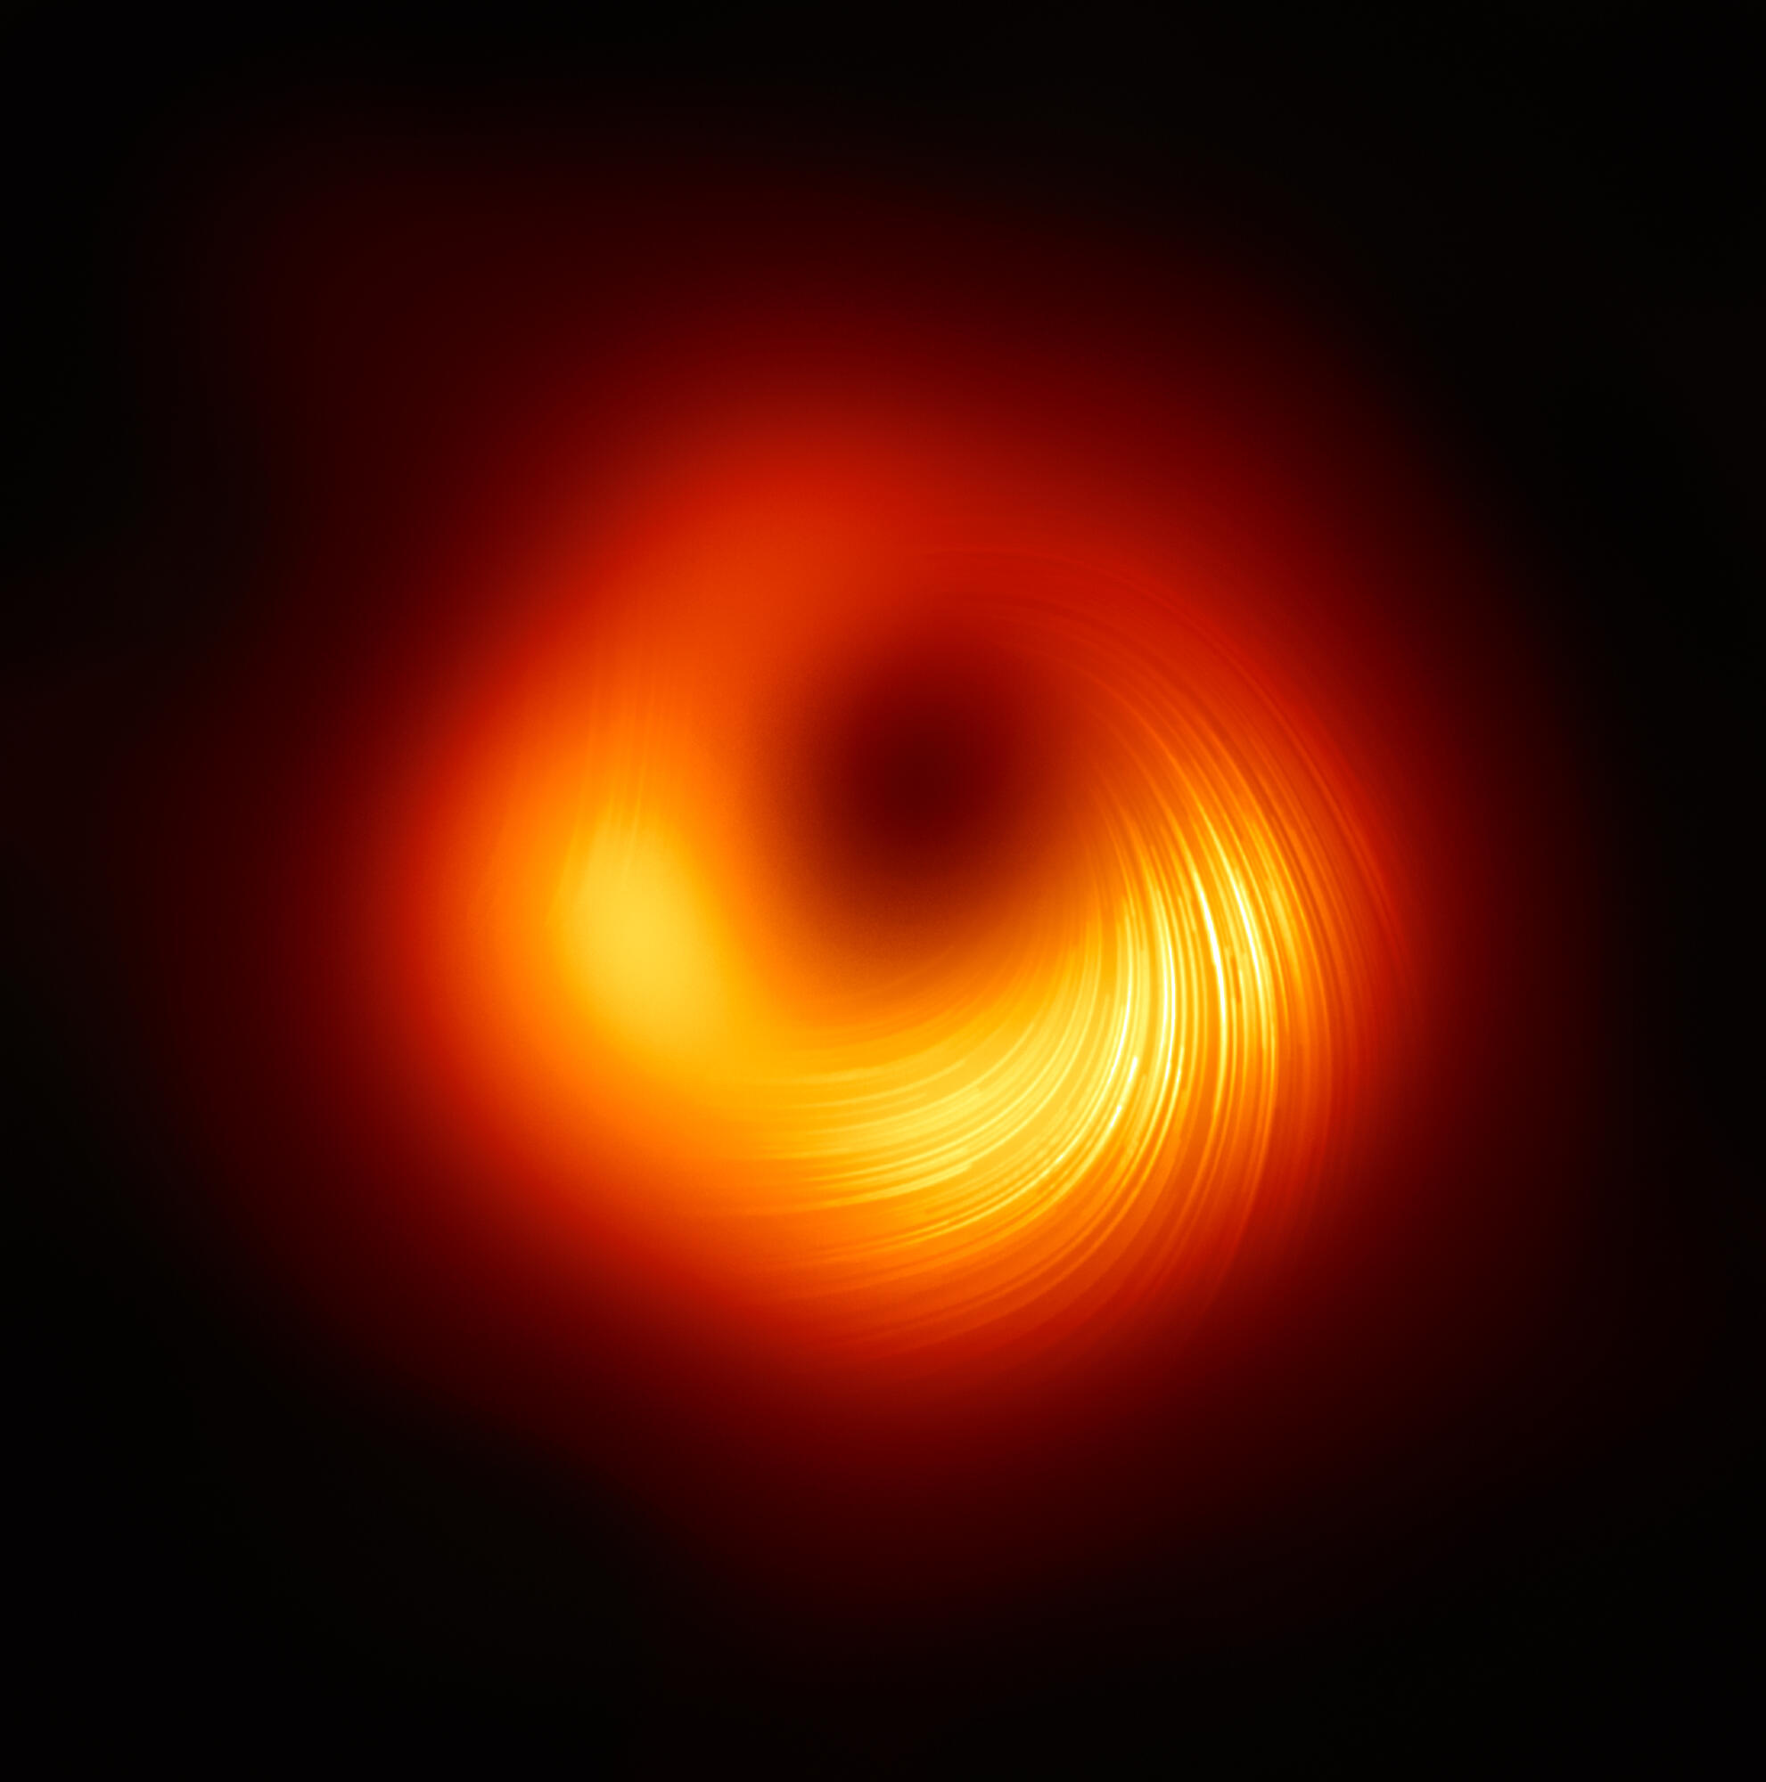
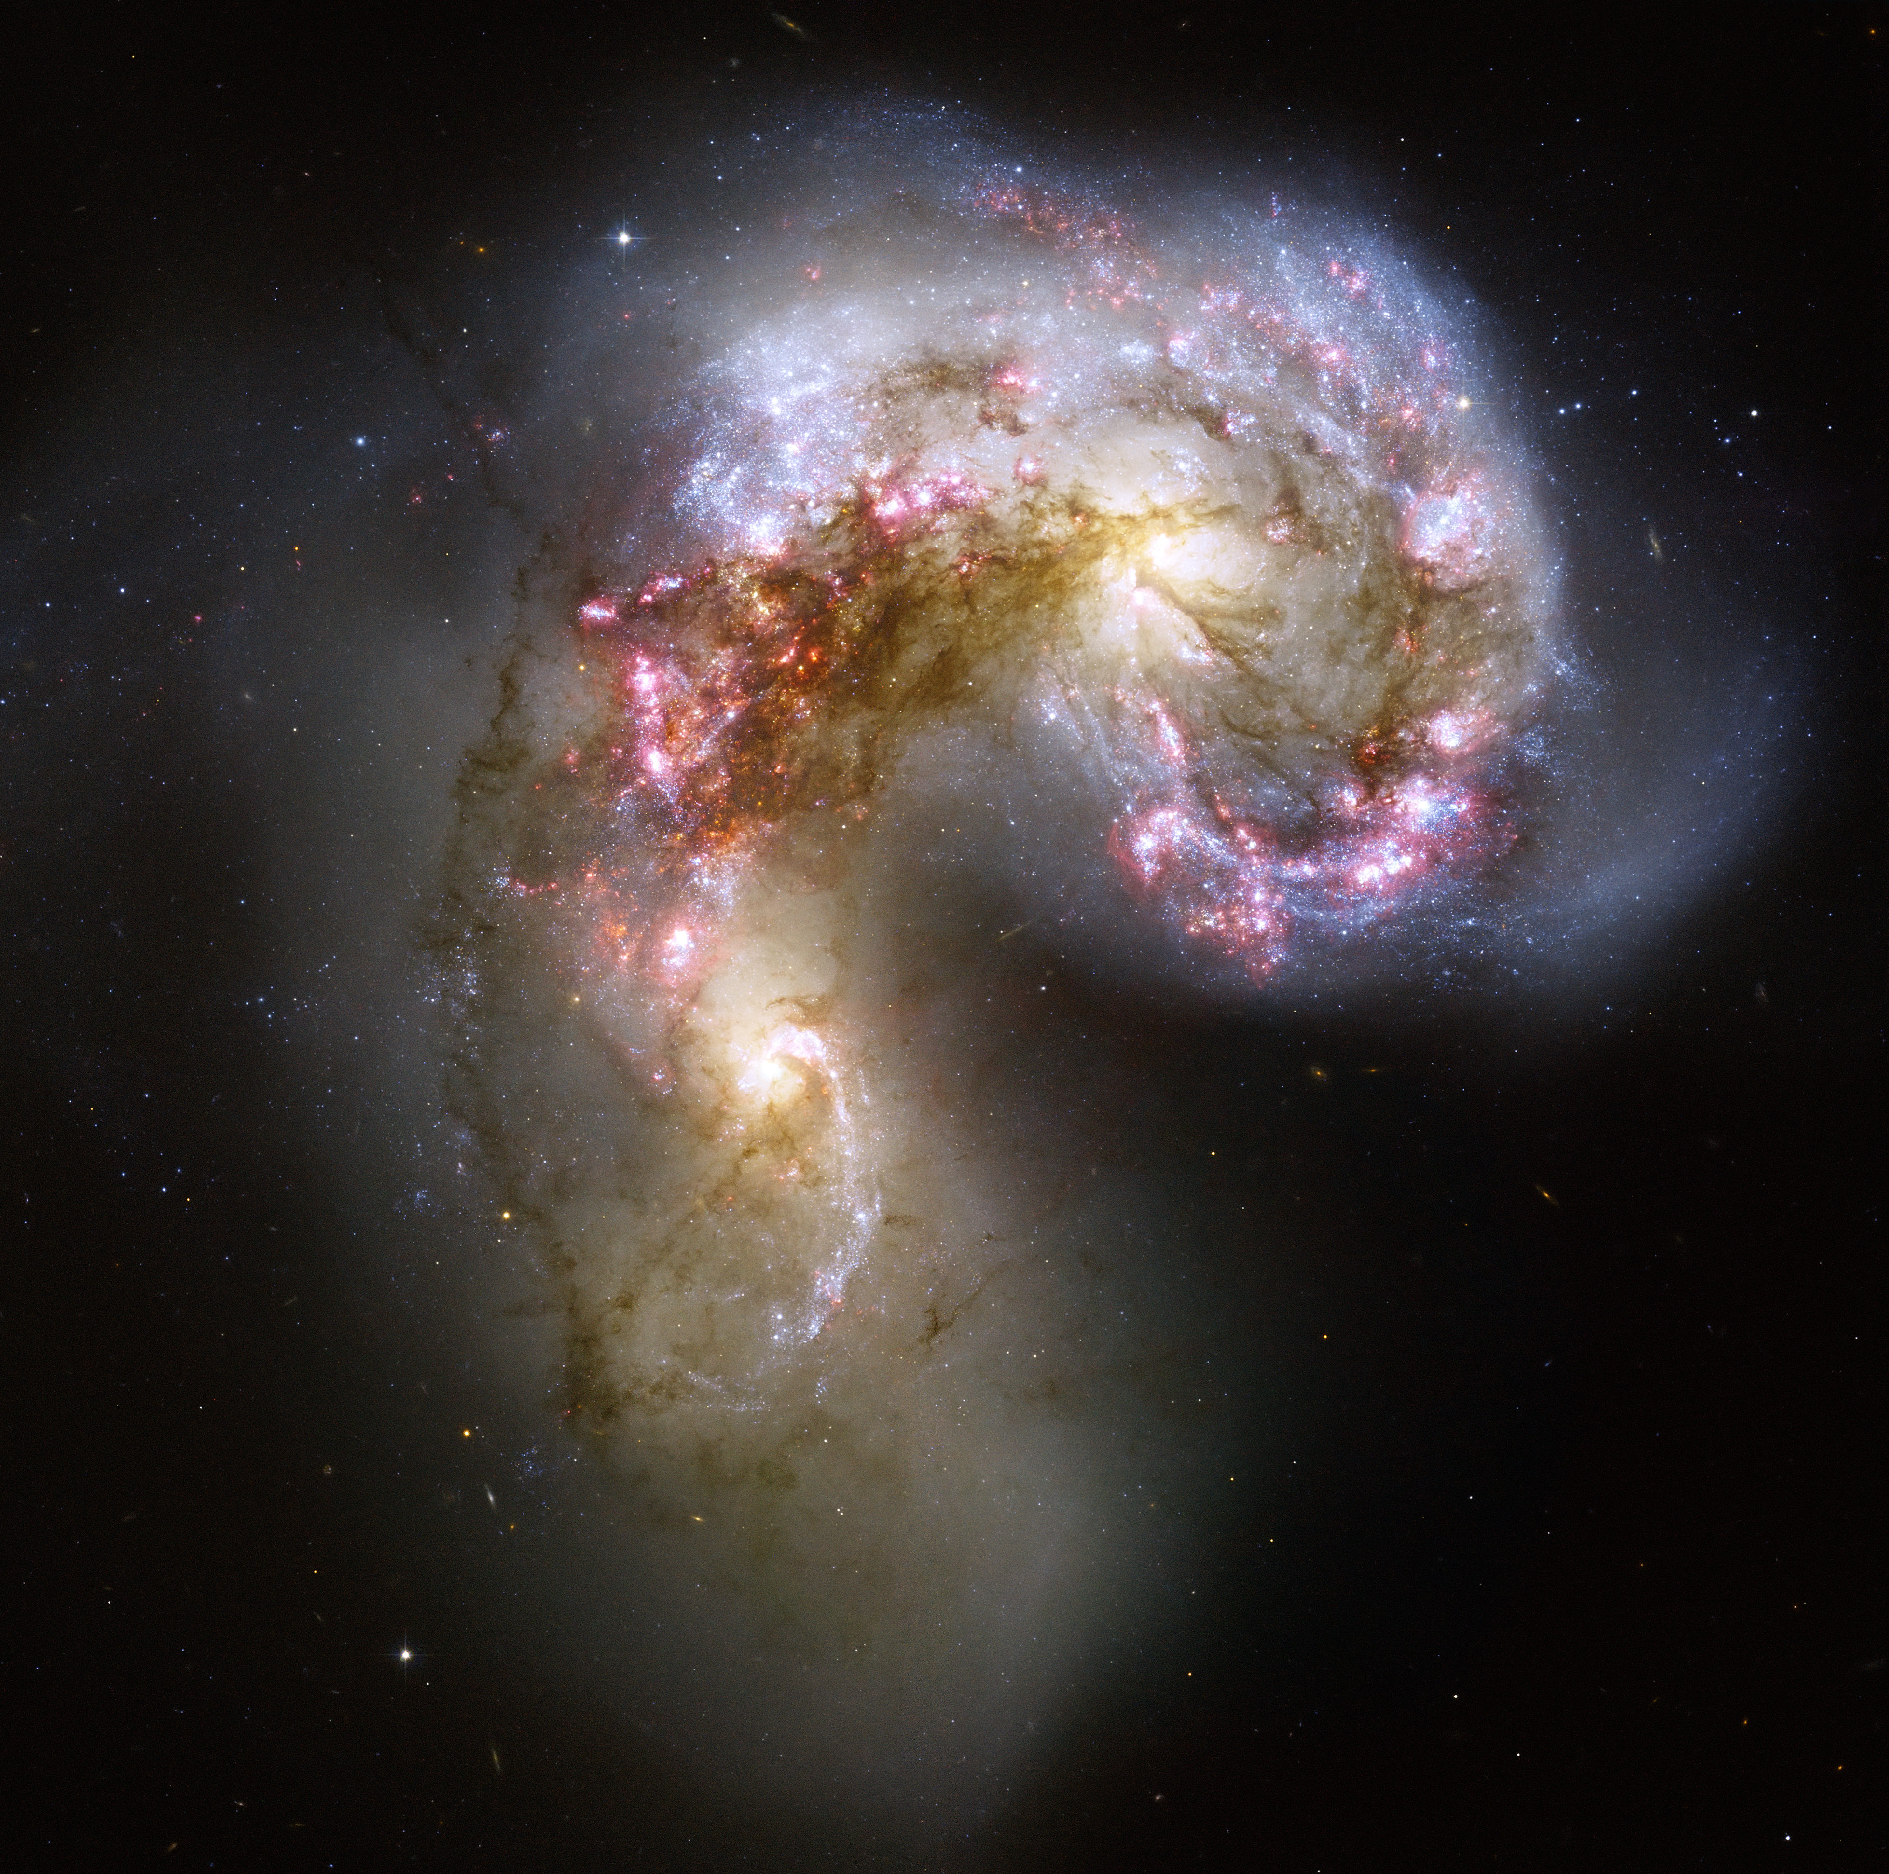
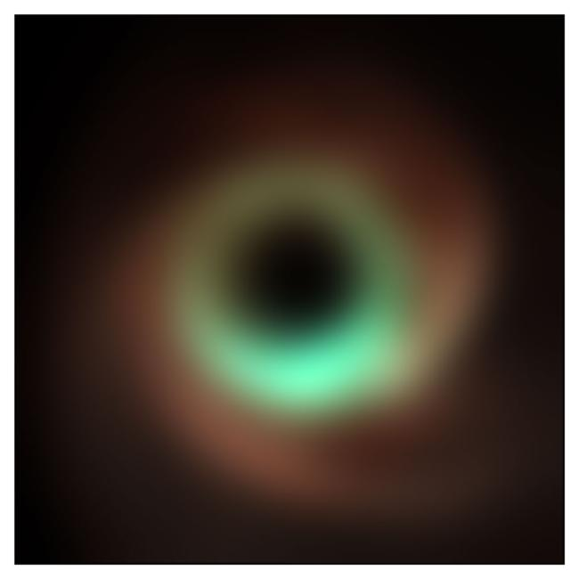
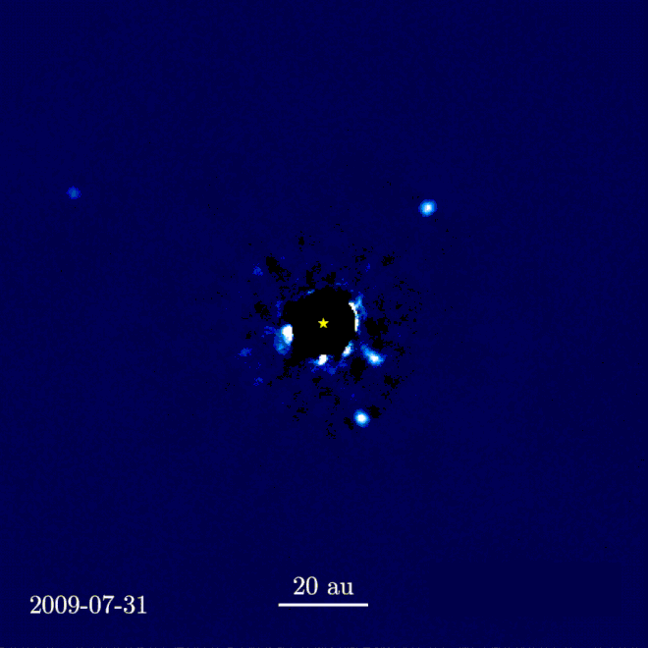
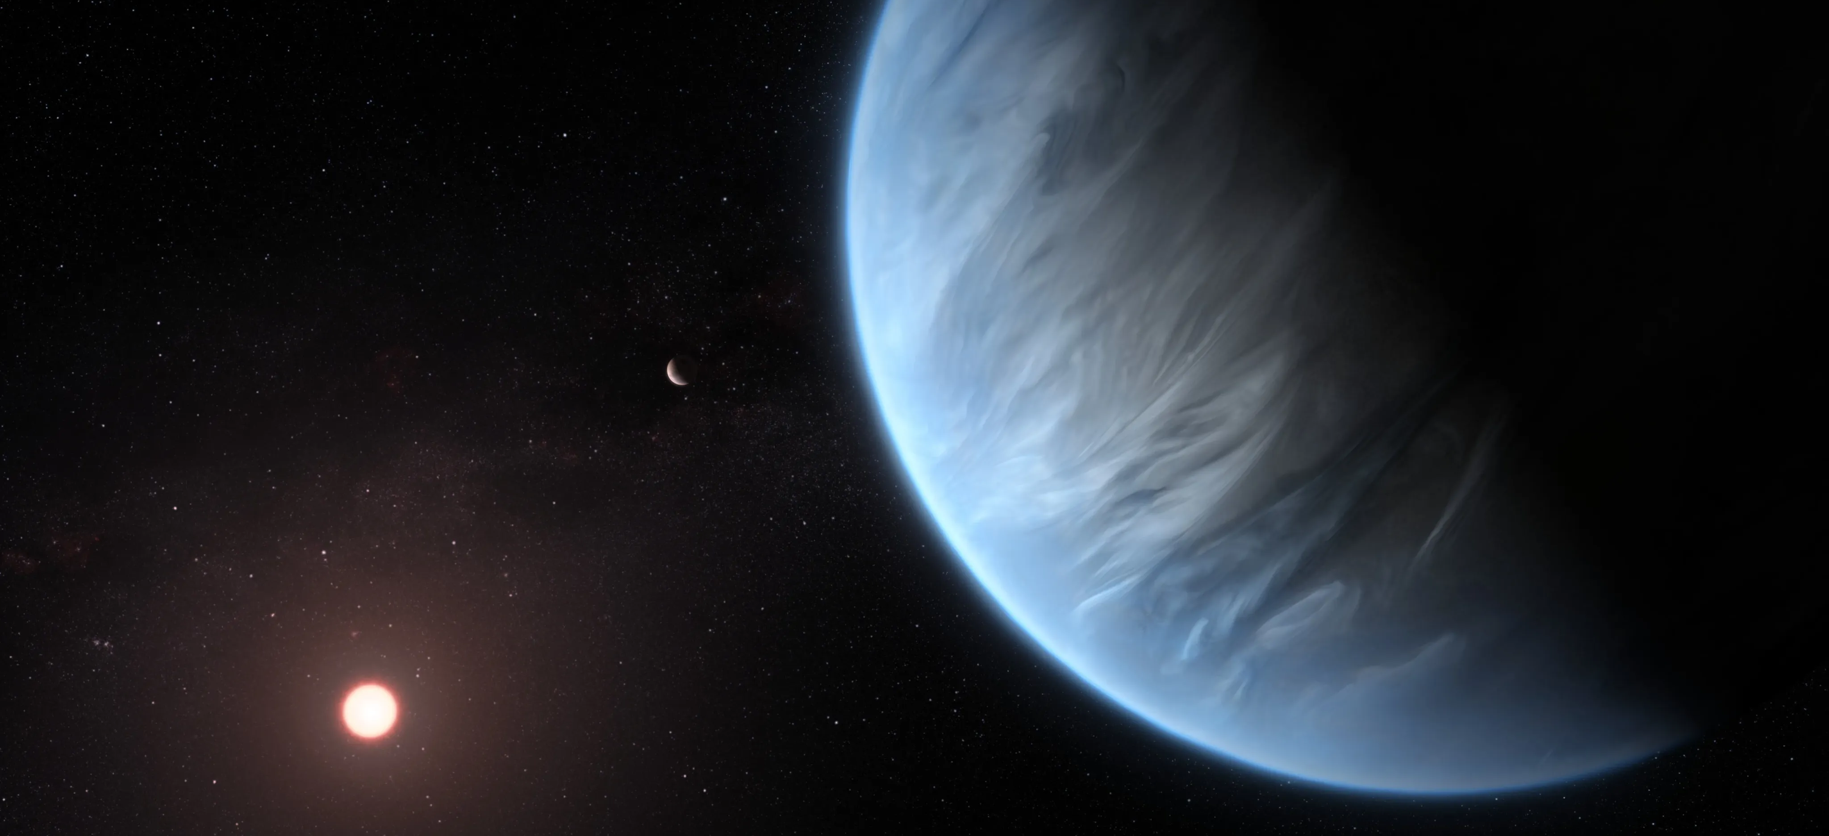
Astronomy
Sagittarius A*
The Antennae Galaxies
Colour Composite of Sagittarius A*
and M87
Exoplanet – Artistic Impression

Slide 3
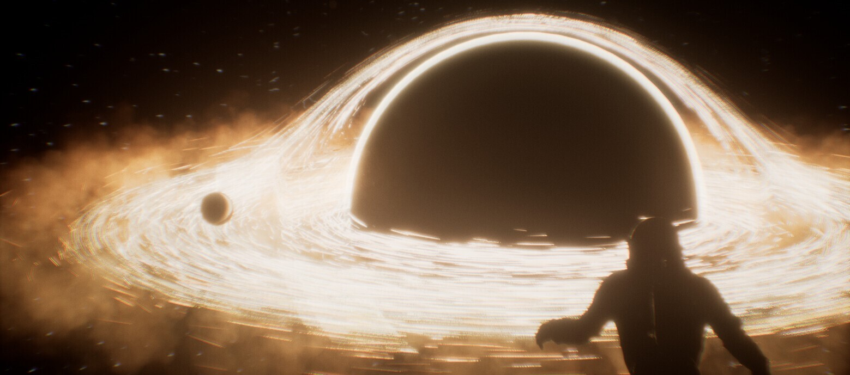
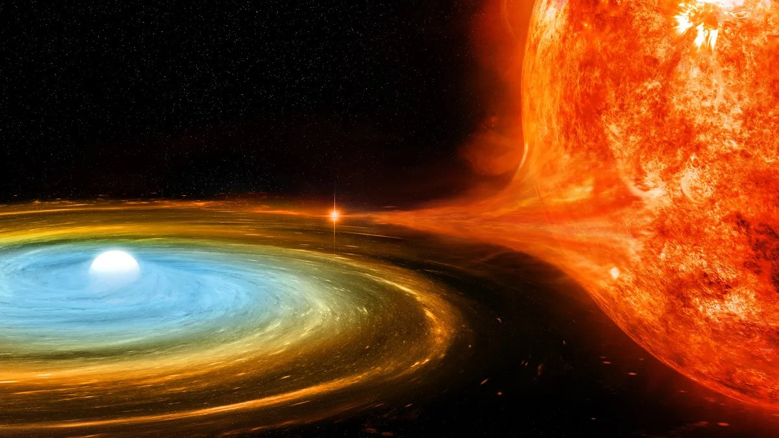
Accretion Wind Modelling
Blackhole
White Dwarf Star
Donor Star
Accretion Discs

Slide 4
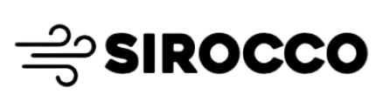
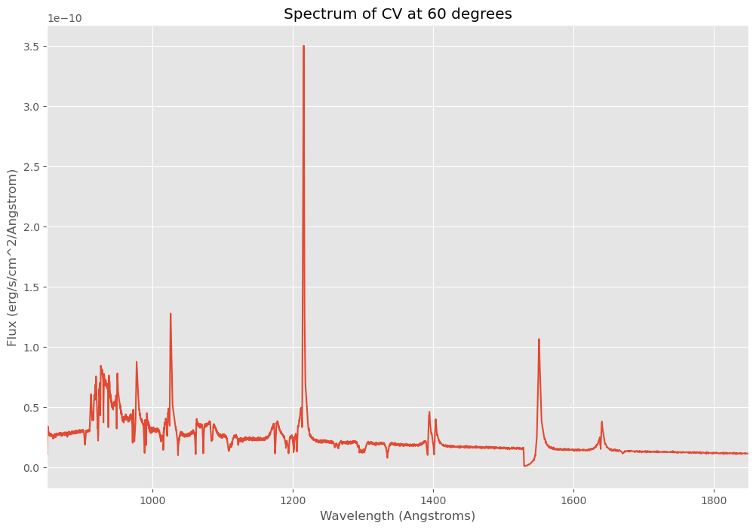
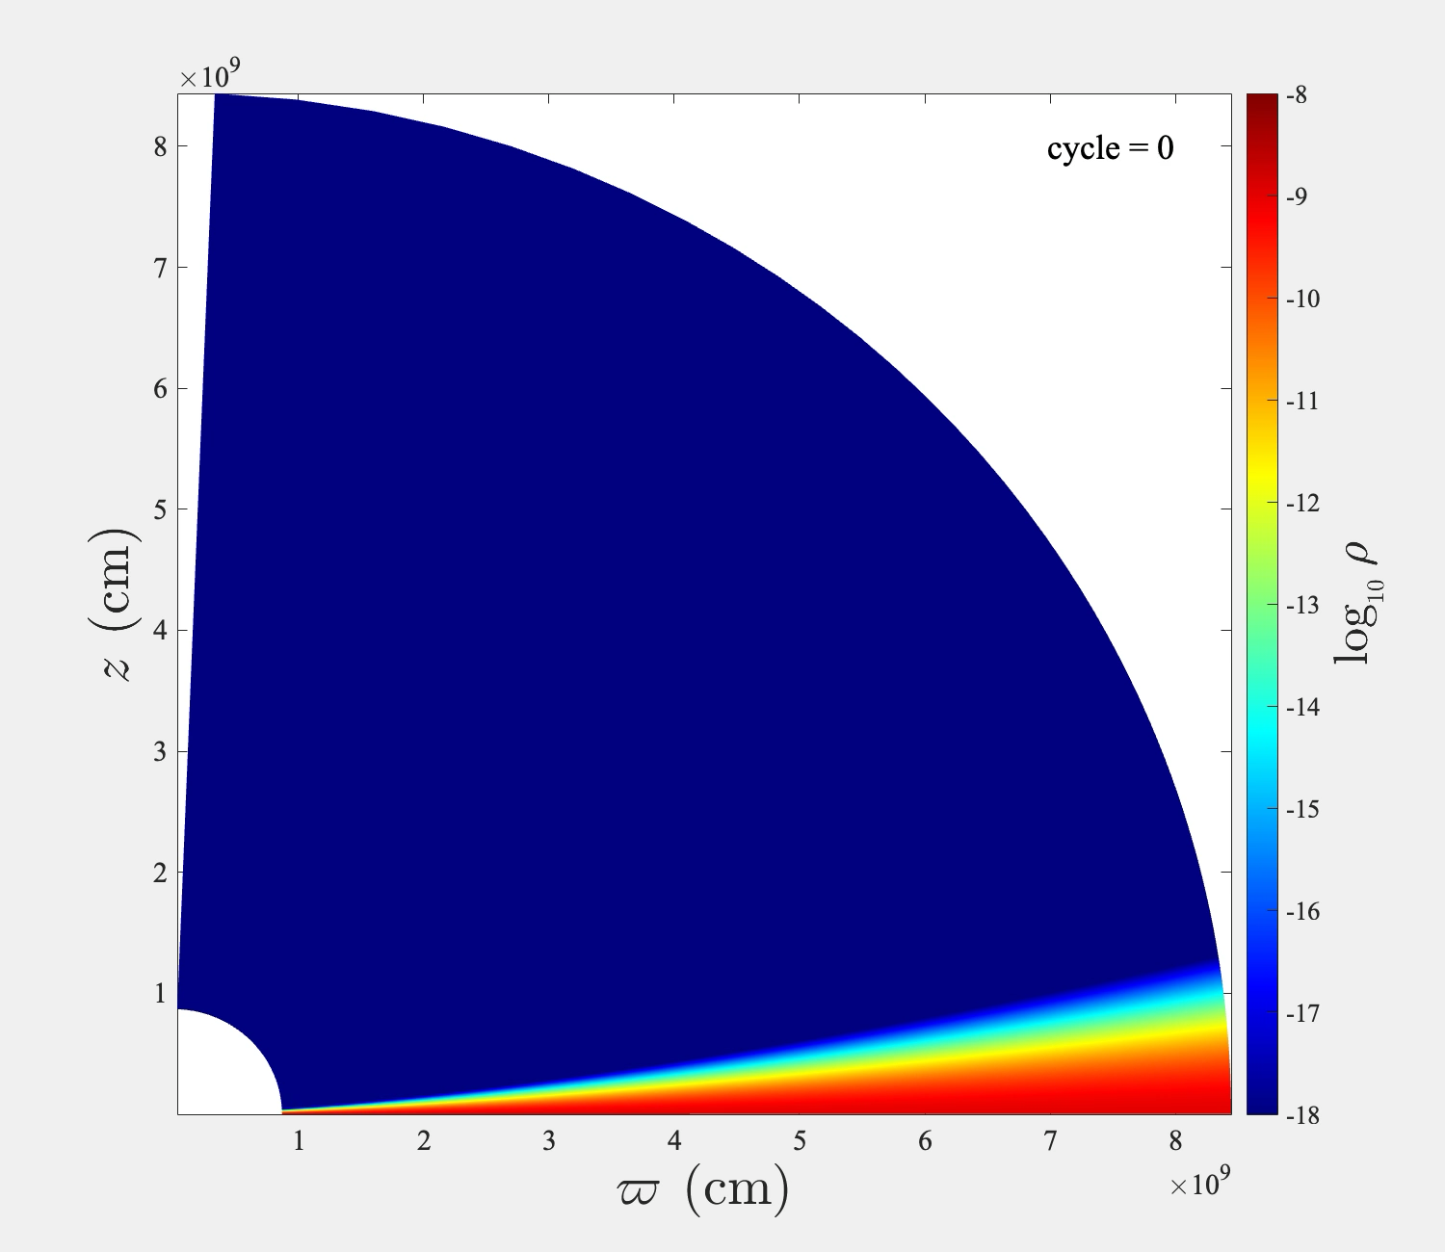
Scientific Modelling
MHD 2D Wind Quadrant Slice
Monte-Carlo Simulations
Star
Accretion disc

Slide 5

Running a Simulation…
Notes:
mpirun –np 4 py cv_wind.pf

Slide 6
Faster Simulations w/ Emulation
Emulation /ˌem.jəˈleɪ.ʃən/ (n)
A machine learning method designed to approximate the behaviour of a more complex and expensive system.
Key Benefits:
Much faster computation times
Simulations can be used for real-time applications
Can perform inference with high-dimensional simulations

Slide 7
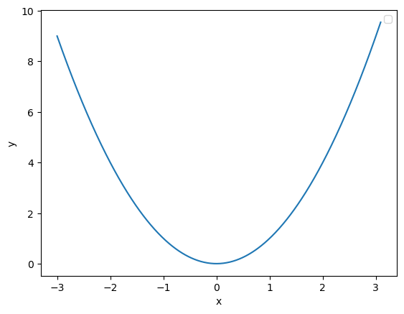


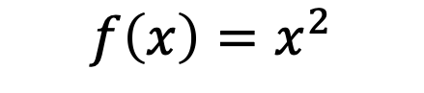
The Simplest Emulator
A linear interpolator … Emulators in their simplest forms can be reduced to basic interpolators
Input parameter
Physics
Simulator
Output
$$x$$
$$f\left(x\right)=x^{2}$$
$$y$$
def quadratic_equation(x, a=1):
return a*x**2

Slide 8
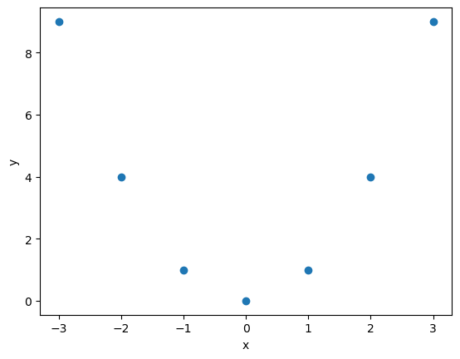
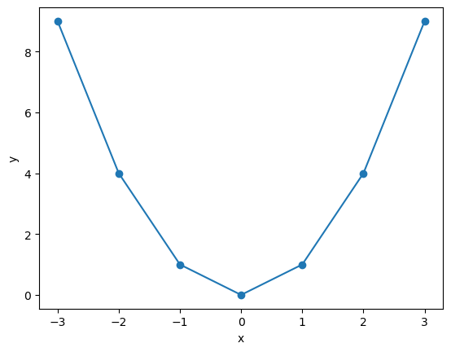
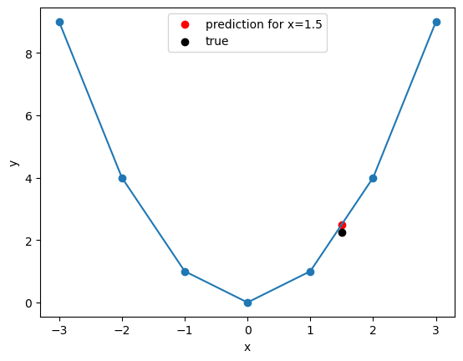
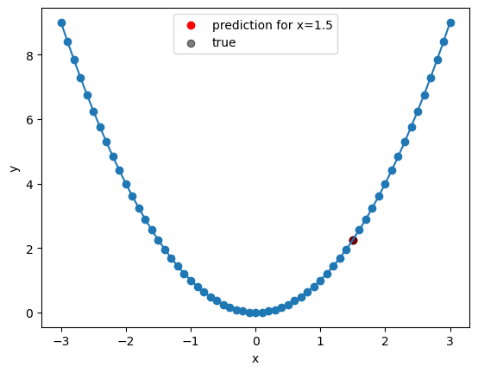
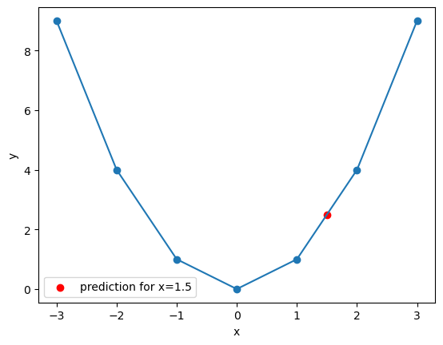

The Simplest Emulator
A linear interpolator … Emulators in their simplest forms can be reduced to basic interpolators
Input parameter
Physics
Simulator
Output
$$x$$
$$f\left(x\right)$$
$$y$$
def polynomial_equation(x, a=1):
return a*x**2

Slide 9
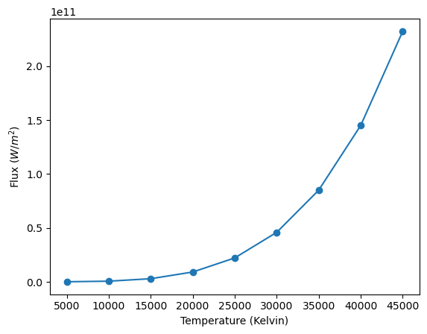
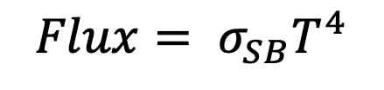
The Simplest Astro Emulator
A linear interpolator … Emulators in their simplest forms can be reduced to basic interpolators
Input parameter
Physics
Simulator
Output
$$x$$
$$Flux= σ_{SB}T^{4}$$
$$y$$
def star_flux(temperature_K):
sb_constant = 5.67e-8 # W/m^2/K^4
return sb_constant * temperature_K**4

Slide 10
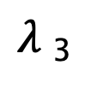
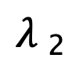
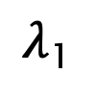
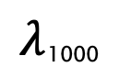
A Complex Astro Emulator
Input parameters
Outputs
Blackhole Mass
Physics
Simulator
$λ$₁
Accretion Rate
$λ$₂
Star Temperature
$λ$₃
N Parameters
$λ$₁₀₀₀

Slide 11
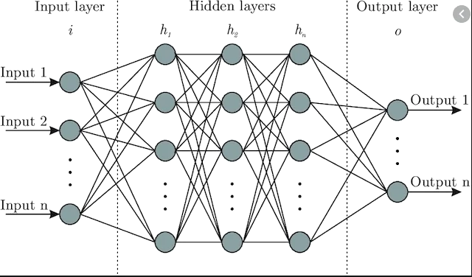
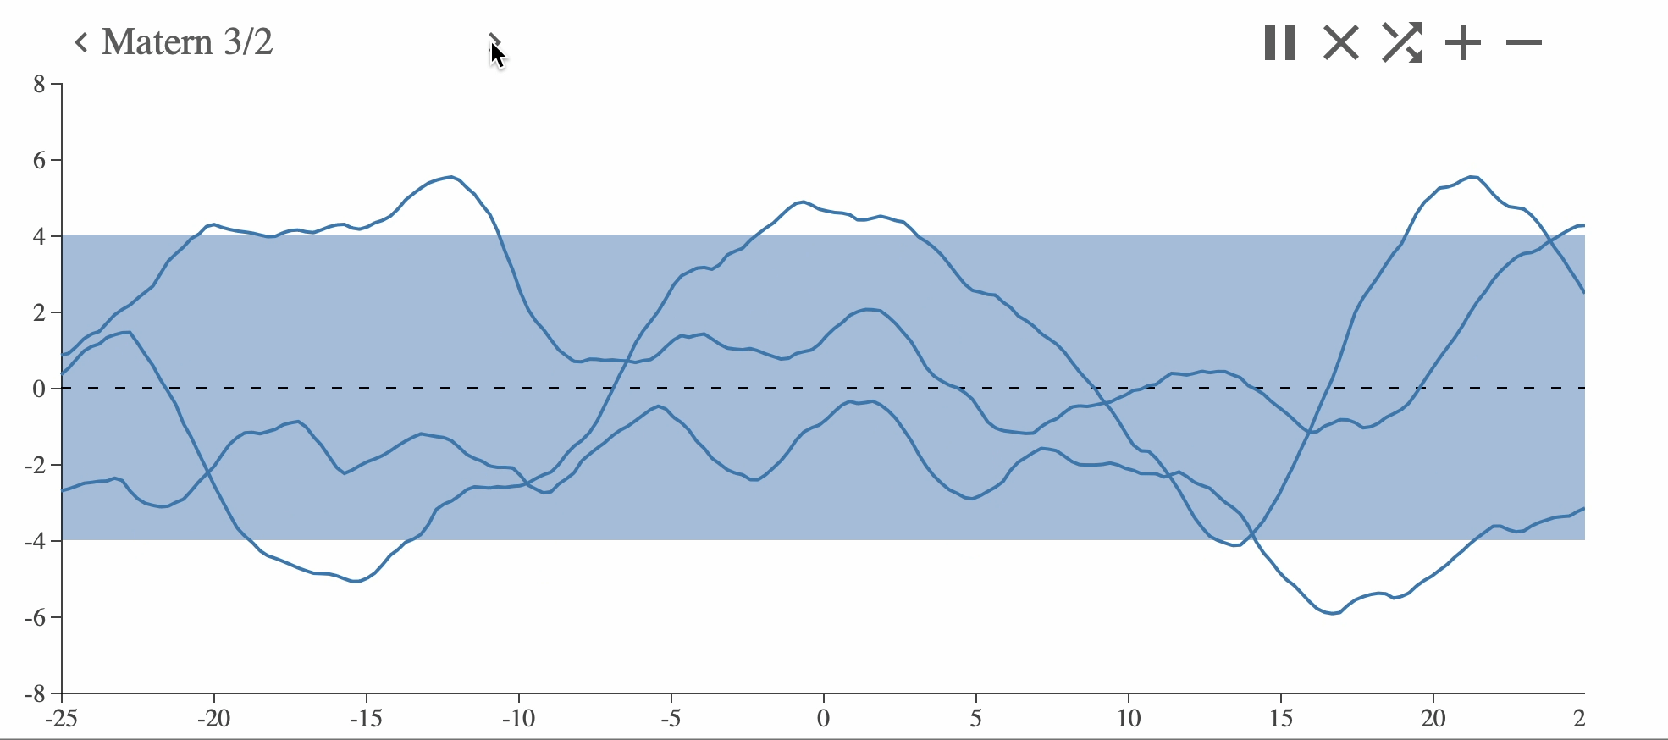
Two Main Emulator Types
Emulators are commonly fancy interpolators using machine learning methods…
Neural Networks Gaussian Processes
Great for:
- Fast-Real Time Use - Uncertainty Quantification
- Less expensive Simulations - Limited training Data

Slide 12
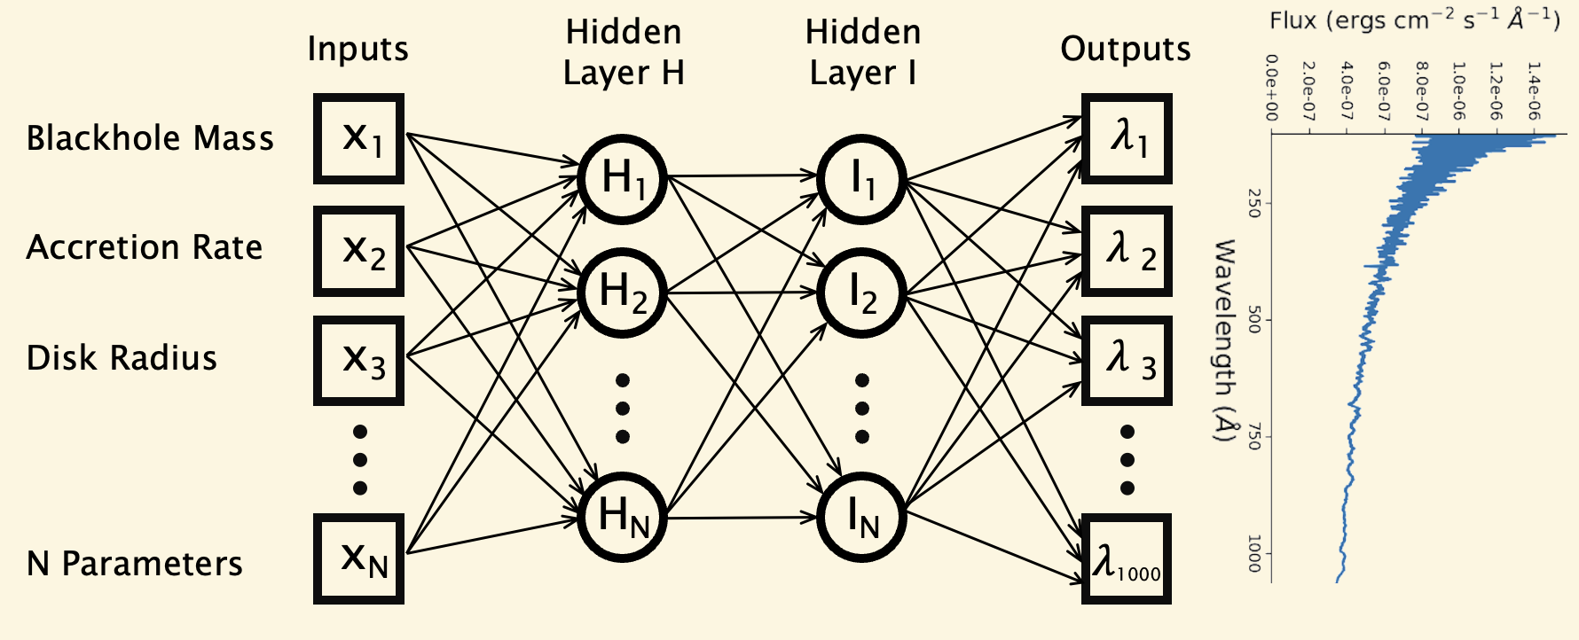
Neural Network Emulators
Simple Training Emulator Workflow:
Sirocco
Simulations
Train/Test Split
Train Feed-Forward NN
Optimal NN Model Saved
However,
we can do better…

Slide 13

NN Hyperparameter Selection
Optuna is a hyperparameter optimisation framework,
Let's you vary parameters such as:
The activation functions (Relu, LeakyRelu etc)
The number of network layers (Deep networks)
The number of neurons per layer (Wide networks)
The optimiser (Adam, AdamW etc)
The weight decay (Regularisation)
Batching size
However,
we can do better…

Slide 14
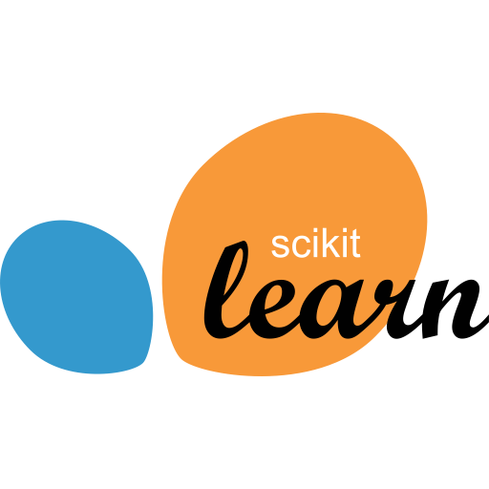
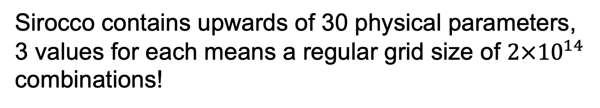
Parameter Selection
Sirocco contains upwards of 30 physical parameters, 3 values for each means a regular grid size of $2×{10}^{14}$ combinations!
Improvements:
Intuition: Restrict to only known important physical parameters.
Run smaller subsets of parameters and feature select through random forests/gradient boosting to identify weak parameters.
Notes:
11 billions years

Slide 15
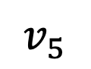
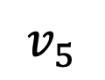
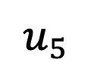
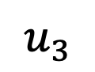
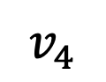
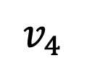
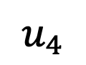
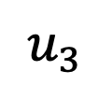
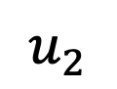
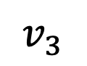
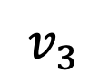
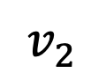
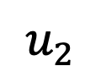
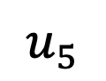
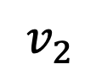
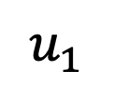
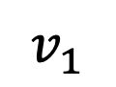
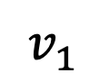
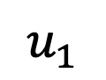
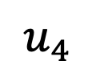
The Latin Hypercube
Sample the grid space to further reduce training simulations.
Random Sampling Latin Hypercube Sampling
$$u_{1}$$
$$u_{2}$$
$$u_{3}$$
$$u_{4}$$
$$u_{5}$$
$$u_{1}$$
$$u_{2}$$
$$u_{3}$$
$$u_{4}$$
$$u_{5}$$
$$v_{1}$$
$$v_{1}$$
$$v_{2}$$
$$v_{2}$$
$$v_{3}$$
$$v_{3}$$
$$v_{4}$$
$$v_{4}$$
$$v_{5}$$
$$v_{5}$$
2D Example

Slide 16
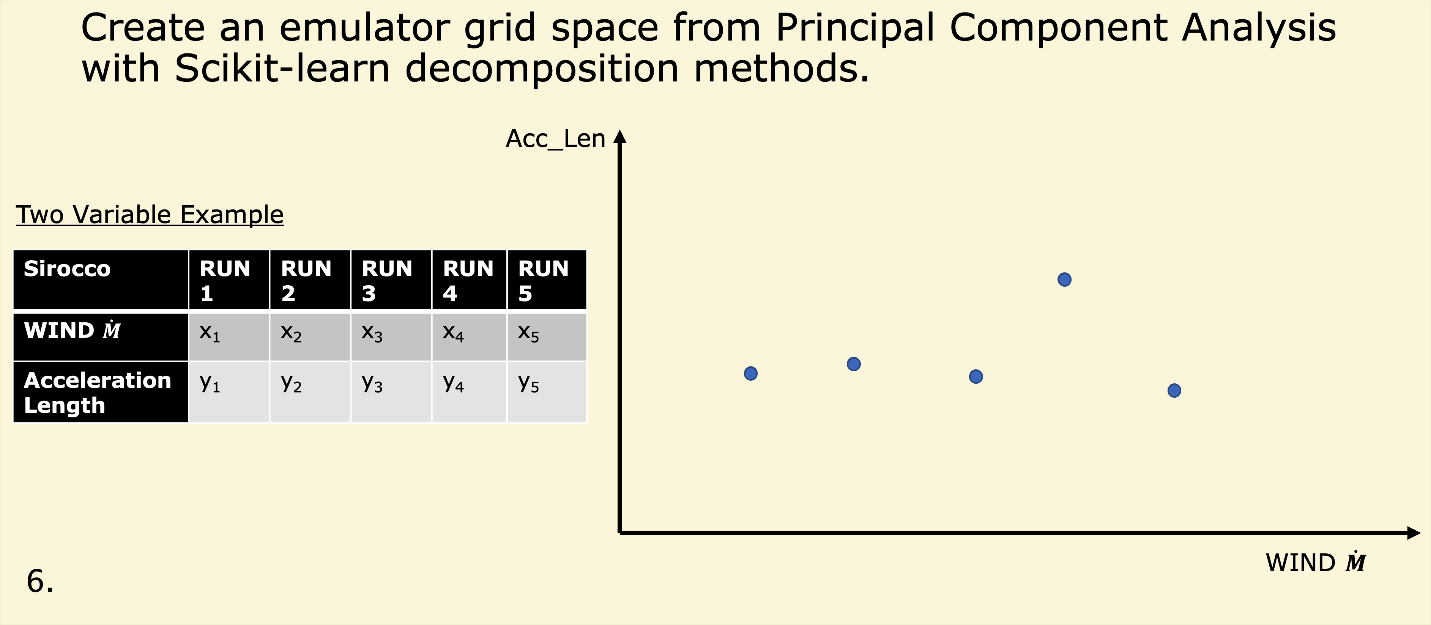

The Latent Space - PCA
You can reduce the number of dimensions
in both inputs and outputs
Illustrative; not to scale

Slide 17
Running a Emulation…
Notes:
mpirun –np 4 py cv_wind.pf
Conda activate speculate_env
Plot_spec.py cv_wind
Open cv_wind.png

Slide 18





Case Study: Fusion Energy
Emulators are being adopted universally
Plasma pressure profiles:
Open-Source Example:
TORAX (Google Deepmind)

Slide 19








Deep Learning Books
Both FREE books with supplementary material…
Dive into Deep Learning (1089 pages)
Understanding Deep Learning (527 pages)
Presentation Resources
A human
(me)

Slide 20

You’ve gone too far … how did you get here!

Slide 21
Title:
Faster Models, Faster Answers: Discover Emulation for Your Workflow
Abstract:
AI this and AI that, the world in the past couple of years has become overrun with news of Generative AI and the ever-improving odds of a takeover from our new robot overlord, ChatGPT. However, have you ever heard about Generative Modelling? This research field is no longer just about creating pretty pictures and making funky tunes about your favourite branded baked beans. No, step with me into the world of Emulation! We’ll probe how simple generative deep-learning models can improve complex physics simulations to not only be rapid but quick as a flash. So, fasten your seat belts as I take you on an ultra-fast whistle-stop tour exploring the universe of surrogate modelling, neural networks and the latent space. As I showcase the raw power of emulators, we’ll uncover how faster models unlock new answers (and questions) in both Astrophysics and fusion energy. Also, we’ll examine introductory examples of how you can build your own emulator from scratch.
For an evening event, you don’t want to miss, I look forward to seeing you there ... and bring a fire extinguisher; my GPU will be on fire 🔥!
Topic keywords: Machine/Deep learning, Generative Modelling, Emulation, Neural Networks, Gaussian Processes, Astrophysics, Fusion Energy, Simulations, Data-processing, Inference (☞⌐▀͡ ͜ʖ͡▀ )☞

